Slide 1
Coordinated Movement
Individuals can
1. make decisions that compliment each other
2. can make a decision as a whole and move in a prescribed, coordinated group
Formation: a set of locations where a character can be positioned. One location is the leader position.
Formation motion is the movement of a group of characters retaining group organisation (under 2.)

Slide 2
Formation Movement
Movement of NPCs so that they retain some group arrangement.
For Example, Fixed Geometric Patterns
Single file, row, V-shape,
Used in
Team Sports, Squad Based games, RTS
and also in
FPS, Driving, Action Adventure
Both Simple and Flexible
more stable and easier to write than collaborative tactical decision making

Slide 3
Fixed Formations
Defined as a set of position slots
locations where a character can be positioned
relative to leader
Leader slot defines origin for position and orientation
Leader moves as normal
Pattern is translated and oriented so that the leader is in the leader slot and facing appropriate direction
Notes:
Line
V or “finger four”
Defensive circle
Two abreast in cover

Slide 4
Fixed Formations
As leader moves so pattern moves
Each character fits into a slot
Can be assigned directly
i.e. match position and orientation without needing kinematic or dynamic steering behavior
Examples:
Line, Circle, Two abreast in cover, V or “Finger Four”

Slide 5
Calculating Position
If slot is at position r_{s} relative to the leader slot then position of NPC at that slot is:
p_{s} = p_{l} + (Ω_{l} * r_{s})
p_{l} = position of leader
Ω_{l} = orientation of leader (in matrix form)
Orientation of NPC in slot is:
O_{s} = w_{l} + w_{s}
W_{l} = orientation of the leader
W_{s} = orientation of slot s, relative to the leader
Or in SFML just use an SF::Trasform
Notes:
orientation in matrix form otherwise know as a rotation matrix (checkout: https://en.wikipedia.org/wiki/Rotation_matrix)

Slide 6
Leader Movement
Movement of NPC should take into account the fact that it is leader
Limits on speed it can turn
Collision detection should take into account the size of the formation
Difficult to use in complex formations

Slide 7
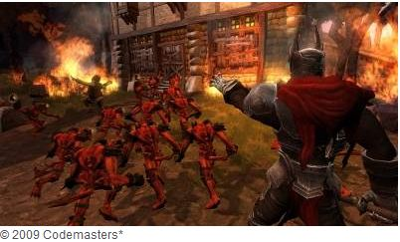
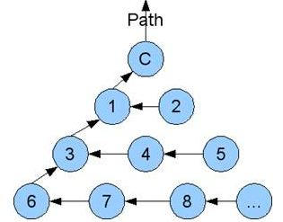
Example - Overlord
Player controls the minions
Minions move in pyramid formation

Slide 8
Example
Squad Movement Formations & Techniques
https://www.youtube.com/watch?v=OKRues4Fwrk
Game of Thrones
https://www.youtube.com/watch?v=dmP35y8xXxU

Slide 9
Scalable Formations?
Scale depending on number of NPCs
Slots are dynamic
No explicit list of slot locations
e.g. defensive circles
Algorithm can be much more complex

Slide 10
Emergent Formations
Another approach to scalability
Each individual NPC uses a steering behavior
Chooses another slot in the formation
(e.g. nearest one)
Uses this as target (if not already being used)
If target is unobtainable
e.g. is in wall or obstacle
choose another slot
Works much like flocking
But formation emerges from individual rules

Slide 11
Emergent Formations
Or specify a general rule e.g. v-formation
Simple and effective
Each NPC can react individually
to obstacles and potential collisions
No need to worry about formation size
But can be difficult to get rules just right
Debugging emergent formations can be difficult
of little use for military groups because of characteristic disorder

